Slide 1
OpenAPI and building an API ecosystem within the organization
Jonas Stensved

Slide 2




CASE / NAMN
Jonas Stensved
Solution Architect
Chief Architect for Inphiz
Web Developer
.NET Developer
Xamarin Developer
Azure Specialist

Slide 3
ABOUT OPENAPI
Open Source under Linux Foundation
Describes REST APIs
Vendor Neutral
Backed by major companies
Can be auto-generated with tools from your API project or created manually
Described in YAML or JSON
(Read more at https://www.openapis.org)

Slide 4
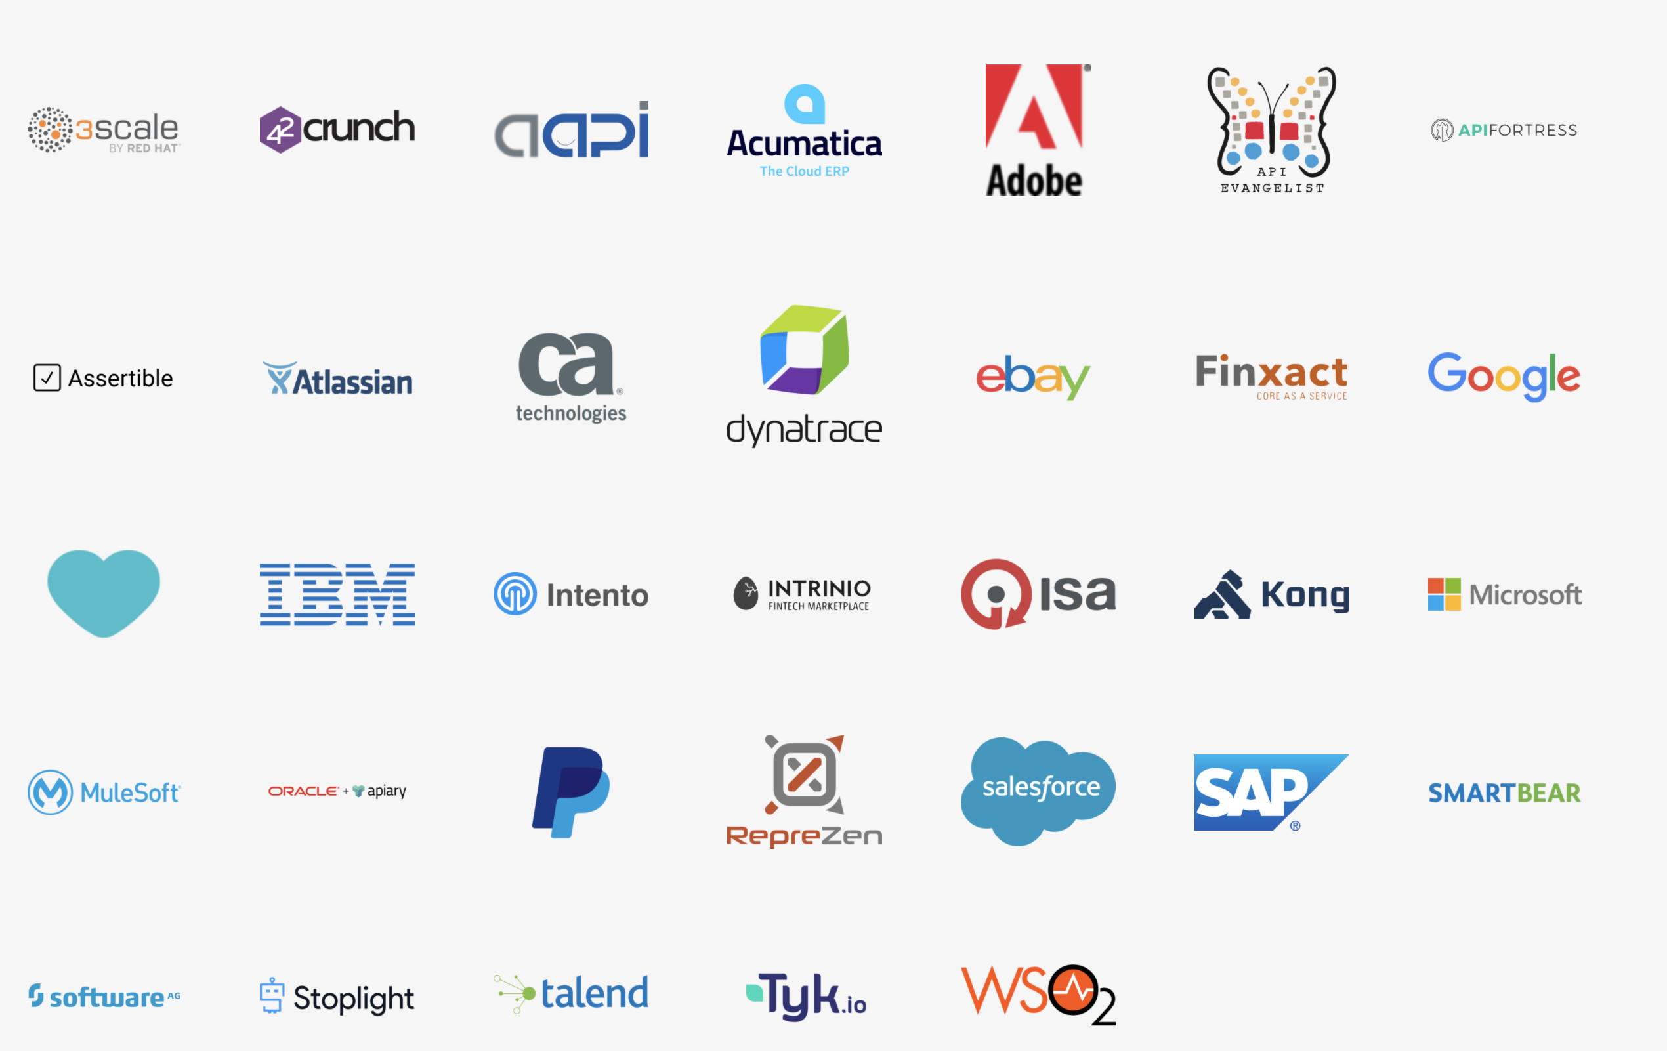
BACKED BY MARKET LEADERS

Slide 5
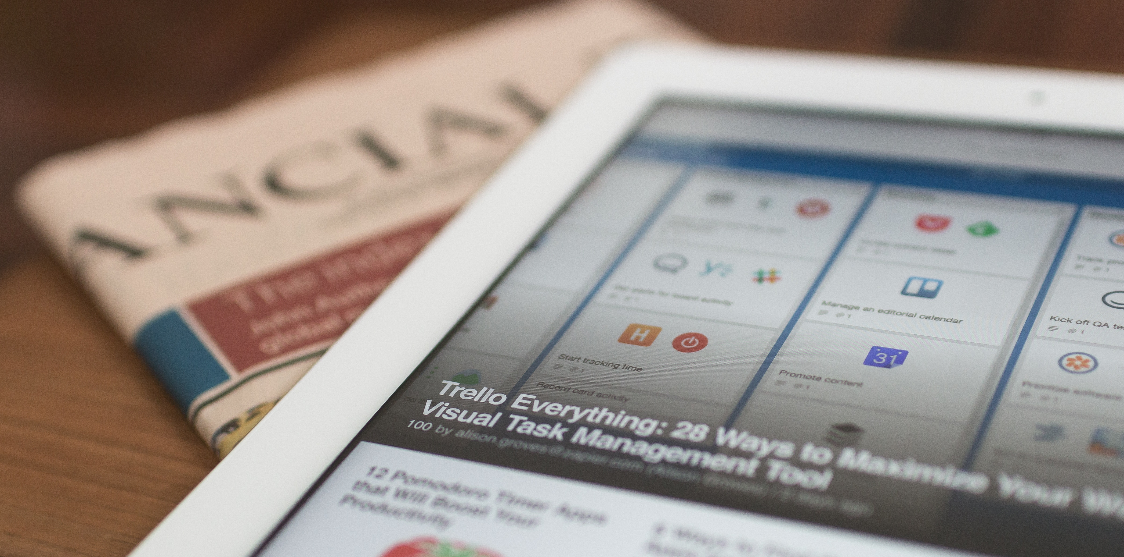
WHAT IS A (DIGITAL) ECOSYSTEM?
A digital ecosystem is a distributed, adaptive, open socio-technical system with properties of self-organisation, scalability and sustainability inspired from natural ecosystems. Digital ecosystem models are informed by knowledge of natural ecosystems, especially for aspects related to competition and collaboration among diverse entities.
* Wikipedia ☺

Slide 6
EVOLUTION OF INTEGRATION TYPES
Integration to
UNKNOWN callers
Integration to
KNOWN callers
Shared
databases
No
integrations

Slide 7
OVERVIEW OF REST API STRUCTURE
REST is short for REpresentational State Transfer
Data is represented as Resources (in collections of items)
Requests are stateless
Uses HTTP Verbs as GET, POST, DELETE, PUT (and PATCH)
Responses are usually in JSON format but doesn’t have to be
Filters are specified in the query string and data in the body
https://company.com/api/products
https://company.com/api/products?category=dishwashers
https://company.com/api/products/123

Slide 8
COMPARING REST VS RPC
If we have a e-commerce API. How would we, using REST compared to RPC accomplish the following task?
Get a list of all dishwashers from the API for a ecommerce mobile app
Get one product with product ID miele-dishwasher-2018
Add it to the basket for the user with username ”igor”
Process the order

Slide 9
USING RPC
GET /api/GetProductsInCategory?name=dishwashers
GET /api/GetProductByName?name=miele-dishwaser-2018
POST /api/AddItemToBasket?product=miele-dishwaser-2018&user=igor
POST /api/CreateOrderFromBasket?user=igor

Slide 10
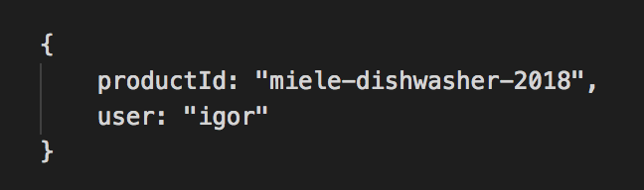
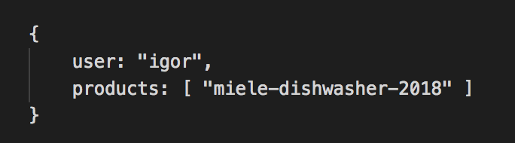
USING REST
GET /api/products?category=dishwashers
GET /api/products/miele-dishwaser-2018
POST /api/basketitems
POST /api/orders
← Here we’re using the body in the POST for data
← Here we’re using the body in the POST for data

Slide 11
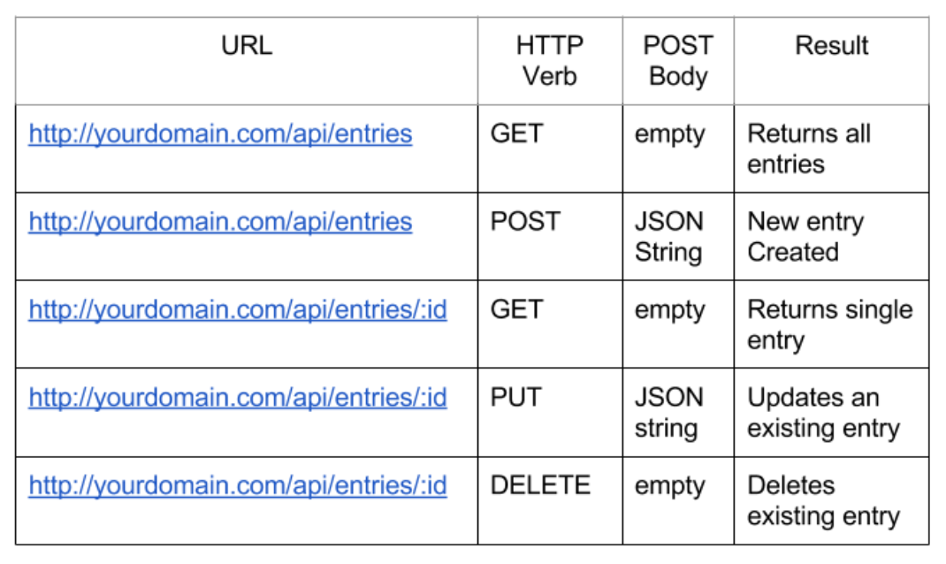
REST API ENDPOINTS
Not designed after to who is consuming the data but after the data itself
Same URL behave different depnding on the http verb (GET, POST, DELETE etc)

Slide 12
Now the client calls and says:
”Hey, we need to list all users with items in their baset to send a reminder about the product name to increase sales. What endpoint should we use?”

Slide 13
If using RPC, where is our endpoint and what data do we get back?
/api/GetProductsInBasketsForAllUsers?
/api/GetBasketItems?
/api/GetItemsInAllBaskets?
Response format?

Slide 14
YOU CAN AUTO GENERATE YOUR API DOCUMENTATION
(Usable for humans, friends and family)
REST API
+

Slide 15
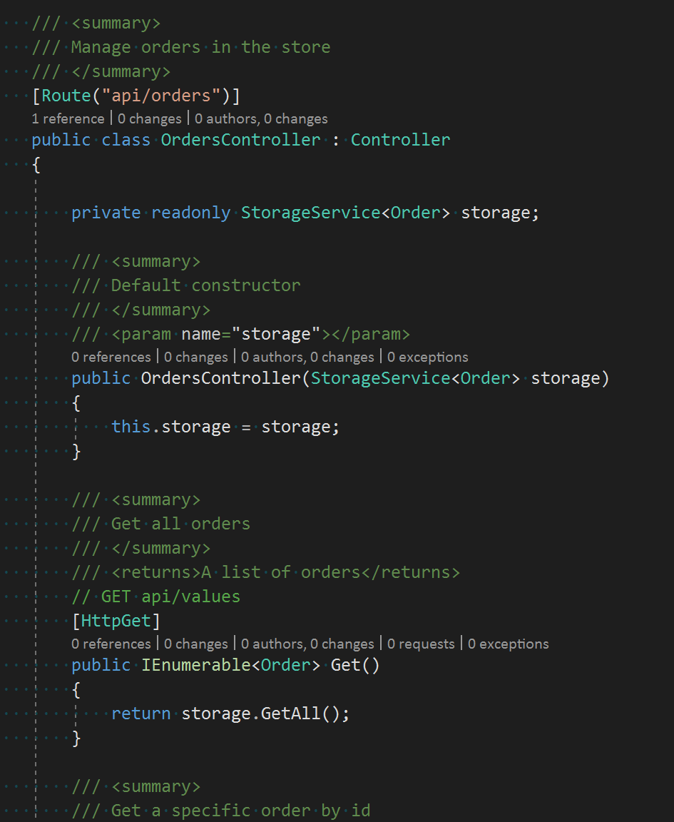
RECOMMENDED TOOLS FOR AUTOGENERATING OPENAPI SPECIFICATION
Using Swashbuckle you can generate swagger from your existing API
Add XML comments in code and get all info in the API
Your API is self-documented directly from code each time you update

Slide 16
Using REST it is easy because we have a structure!
We sent data to the API using POST to /api/basketitems so we only need to fetch the data with a GET to the same url to get ALL basketitems.
What do we get back? – The same entity we put it!

Slide 17

OLD WAY OF INTEGRATING TO APIS
REST API
External API – Coding needed to send data from our API
Internal API – Coding needed to create the integration

Slide 18

NEW WAY OF INTEGRATING TO APIS
REST API
Integration Service
With an integration service we can now recieve data from any service without having to integrate specifically to every API just by providing our specification to the service.

Slide 19
INTEGRATION SERVICES
Sometimes called iPaaS – Integration Platform as a Service

Slide 20
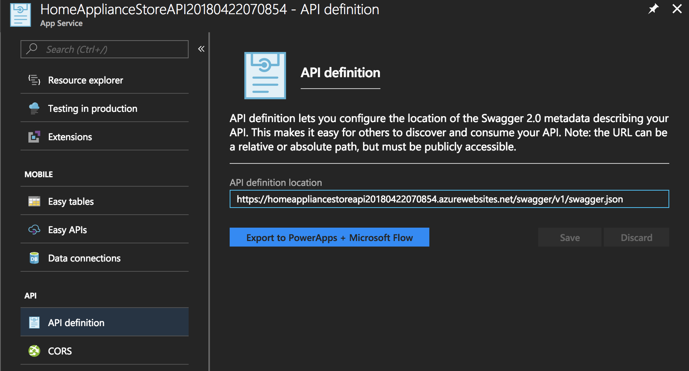
PUBLISH YOUR API FOR ANYONE TO USE IN YOUR ORGANIZATION
Connect to Logic Apps,
Microsoft Flow & PowerApps

Slide 21
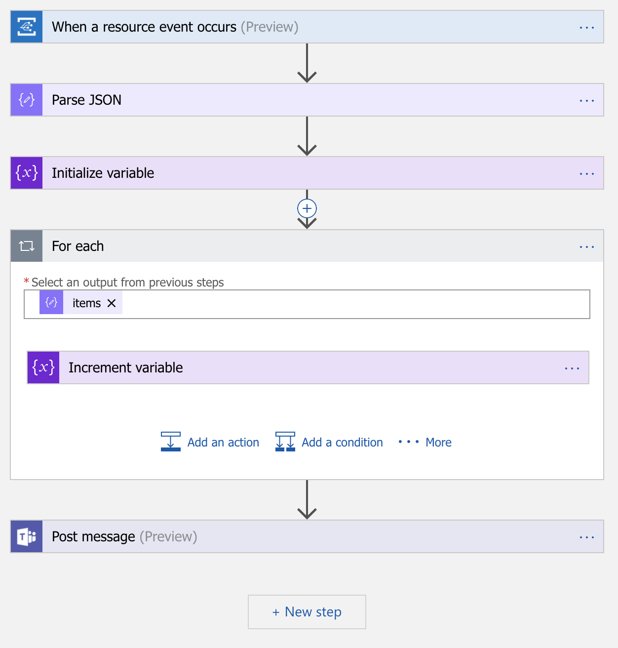
USING LOGIC APPS IS EASY
Azure Logic Apps is an integration service from Microsoft
Map data between services
Create complex workflows in the GUI
Call services for advanced processing
App Service can consume your published API right out of the box

Slide 22
FLOW IS SUPER EASY TO USE
Microsoft Flow is a end-user friendly way of connecting your data.
Built on top of Logic Apps
Let users create integrations themselves
As easy as it gets – you can even add integrations from the mobile app!

Slide 23
MULTIPLE INTEGRATIONS USING EVENT GRID
E-STORE API
Bot sends create order request from conversation in chat
E-store send event notifiying listeners that orders have been created
Chat Bot
Logic Apps
Event Grid
Connect unlimited
APIs by listening to events with logic apps

Slide 24
DEMO!

Slide 25
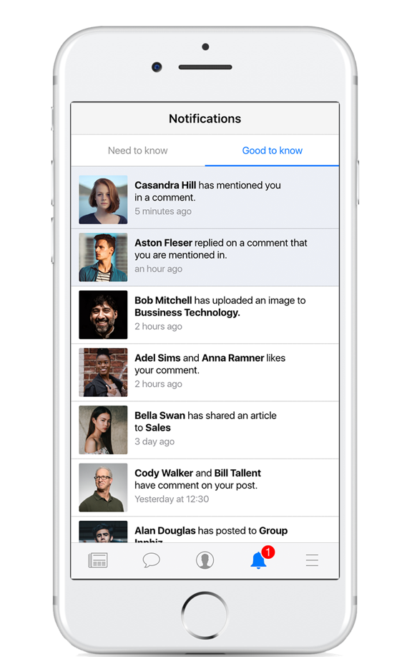
CASE: NOTIFICATION CENTER
Notifications on everything you need to know or is good to know in one place. You can even add push notifications if you like.
Let any backend system, legacy or brand new, send push notifications to the user with a single call to Inphiz
Let users create their own notifications from Office 365 using Microsoft Flow in a user-friendly interface.
Reduce clutter from all channels by moving them automatically sorted categories ”Need to know” and ”Good to know” using AI technology
Let all users decide if a notifications should be only visible in the app or also shown as a push notification

Slide 26
*Ä’
LEARN MORE
Read more and continue learning with your own integrations
Azure.com
Logic Apps
Microsoft Flow
Azure App Service
Event Grid
Open API – http://www.openapis.com
Swashbuckle (Auto-generate swagger from your ASP.NET (Core) API

Slide 27
CASE / NAMN
QUESTIONS?
Please feel free to ask or reach out after this session!
Jonas Stensved
Solution Architect
jonas.stensved@avantime.se

Slide 28
THANK YOU!

